Slide 1
SAP EWM EXTENDED WAREHOUSE MANAGEMENT TRAINING
AnubhavTrainings.com
www.anubhavtrainings.com

Slide 2

SAP EWM TRAINING
BY:-
Mr. Bijoy
www.anubhavtrainings.com
Notes:
https://unsplash.com/photos/uXB-7la5vqA

Slide 3
SAP EWM TRAINING (Day 15)
AnubhavTrainings.com

Slide 4
LOSC (Layout Oriented Storage control)
Concept & Business scenario for LOSC
Understanding complex Putaway process in SAP EWM
Configuration related to LOSC
Testing of Putaway process with LOSC

Slide 5
EWM Replenishment Process
What is Replenishment?
Replenishment is an internal process and is used to fill up a picking area in accordance with the demand for products. Normally warehouses have primary picking zones and buffer zones to manage their inventory. These primary zones are maintained near to door areas to use as picking areas and maintained with predefined maximum, minimum stock quantity levels. Whenever any product's stock level falls below minimum stock level, a replenishment WT executes to fill stock up to maximum level.
www.anubhavtrainings.com

Slide 6
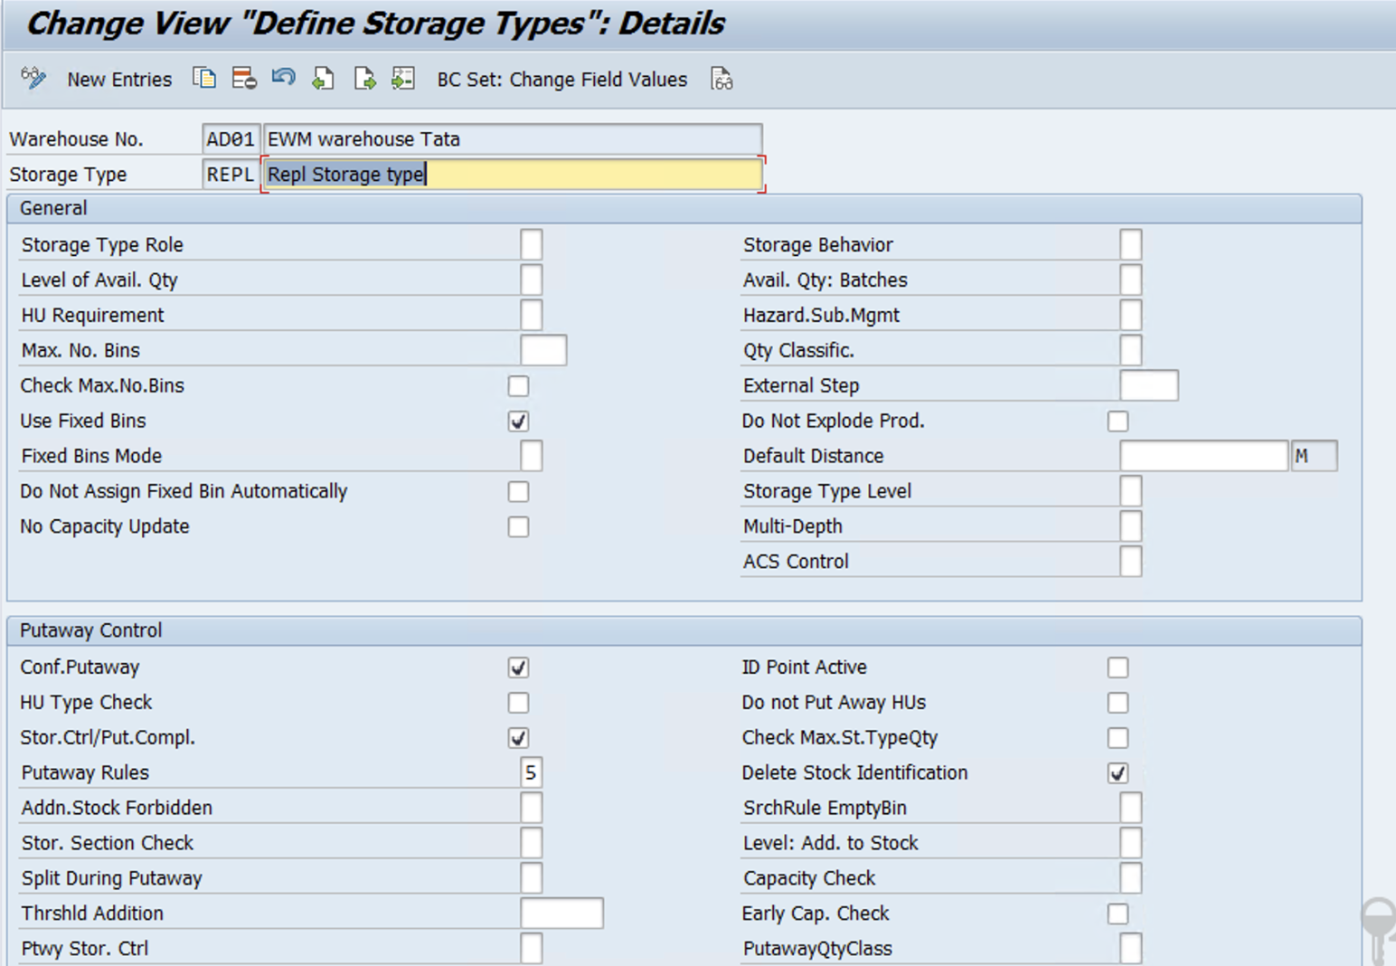
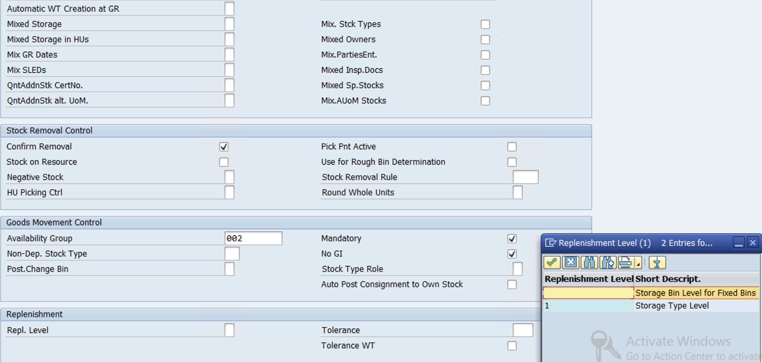
Planned Replenishment Configuration -
Storage type for Replenishment
www.anubhavtrainings.com

Slide 7
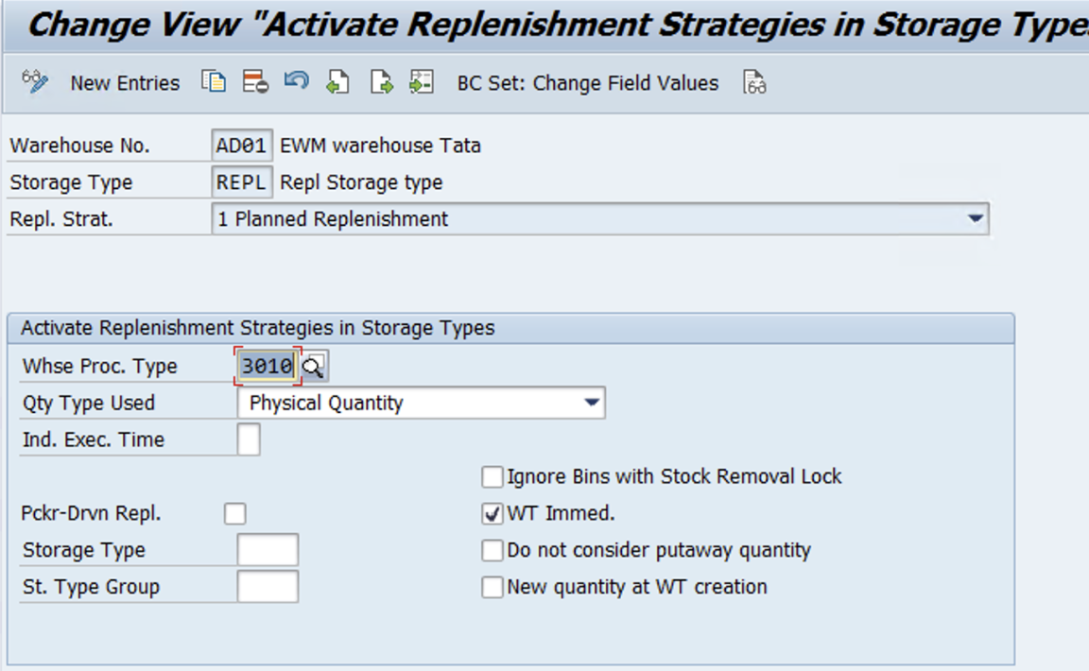
Activate Replenishment Strategies in Storage Types
SPRO-IMG-SCM Extended Warehouse Management-Extended Warehouse Management-Internal Warehouse Processes-Replenishment Control-Activate Replenishment Strategies in Storage Types
www.anubhavtrainings.com

Slide 8
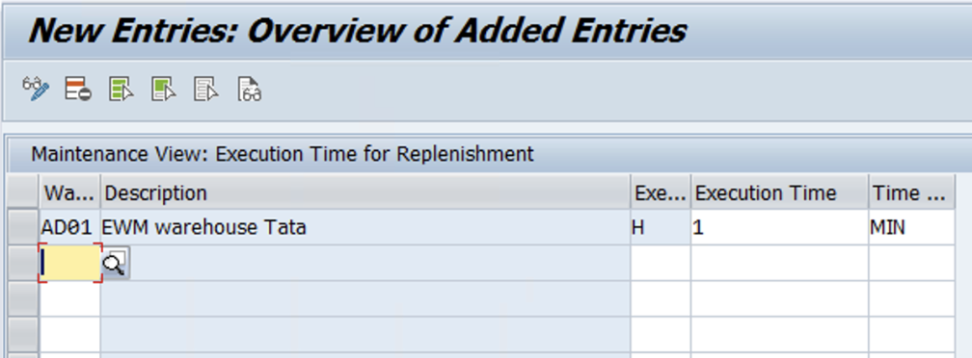
Configure Execution Times for Replenishment
SPRO-IMG-SCM Extended Warehouse Management-Extended Warehouse Management-Internal Warehouse Processes-Replenishment Control- Configure Execution Times for Replenishment
www.anubhavtrainings.com

Slide 9
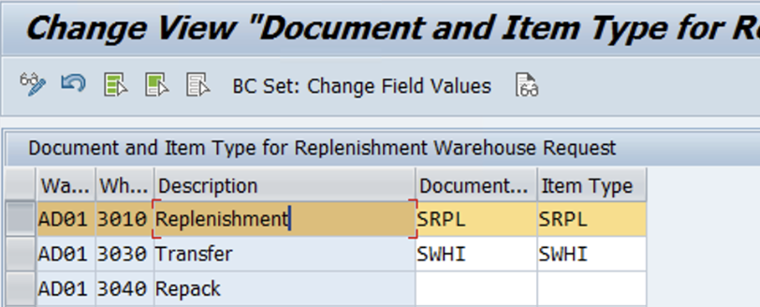
Maintain Document/Item Categories for Replenishment Warehouse Request
SPRO-IMG-SCM Extended Warehouse Management-Extended Warehouse Management-Internal Warehouse Processes-Replenishment Control- Maintain Document/Item Categories for Replenishment Warehouse Request
www.anubhavtrainings.com

Slide 10
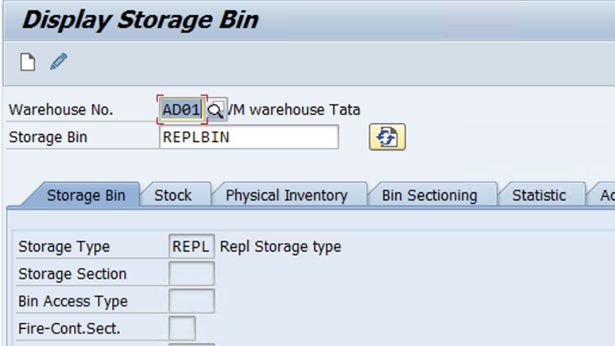
Create Storage bin in the replenishment storage type

Slide 11
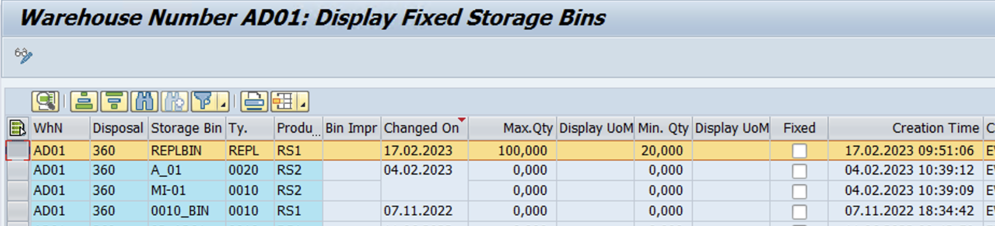
Planned Replenishment:
During planned replenishment the system calculates the replenishment in accordance with the defined Min. Qty and Max. Qty. Replenishment control is triggered when the stock is less than the minimum quantity. The system then rounds down the replenishment quantity to a multiple of the minimum replenishment quantity. The replenishment quantity is the calculated quantity for which the warehouse task or the warehouse request is created
Assign Fix Bin - /SCWM/BINMAT

Slide 12
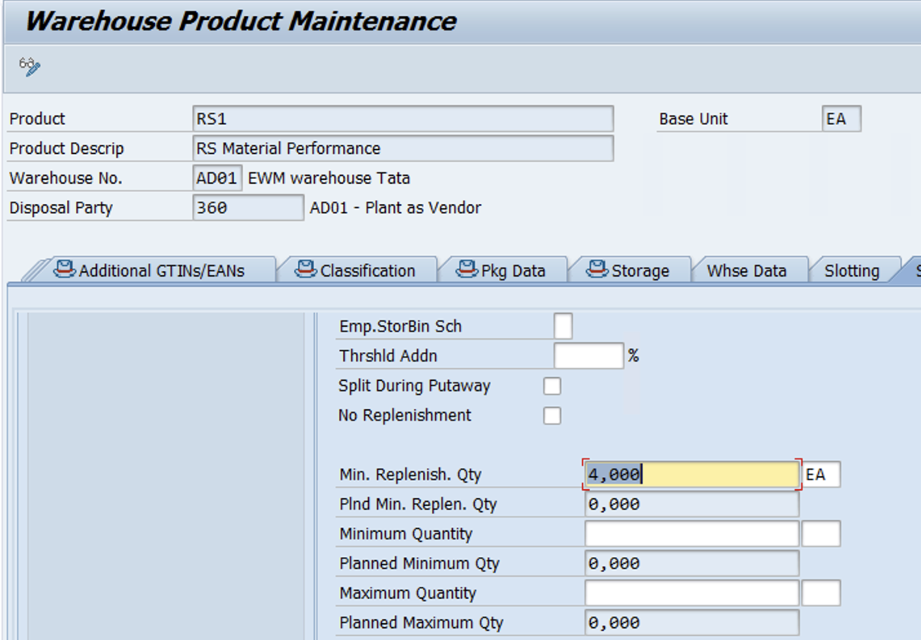
Maintain Min qty in Product master

Slide 13
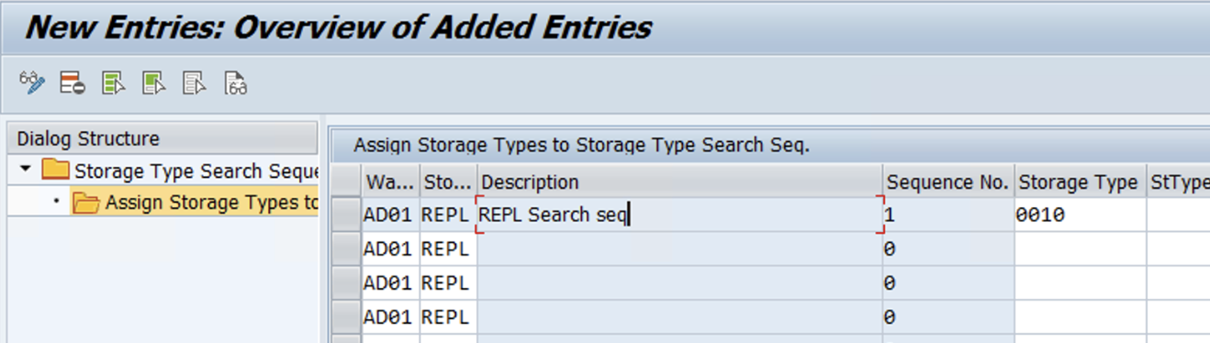
Configure the Removal Strategy for Stock Replenishment
SPRO-IMG-SCM Extended Warehouse Management-Extended Warehouse Management-Goods Issue Process-Strategies-Specify Storage Type Search Sequence
www.anubhavtrainings.com

Slide 14
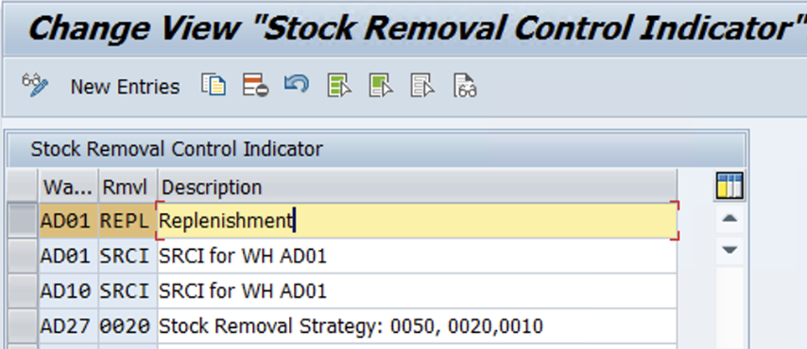
Define Stock removal control indicator
SPRO-IMG-SCM Extended Warehouse Management-Extended Warehouse Management-Goods Issue Process-Strategies- Define Stock Removal Control Indicator
www.anubhavtrainings.com

Slide 15
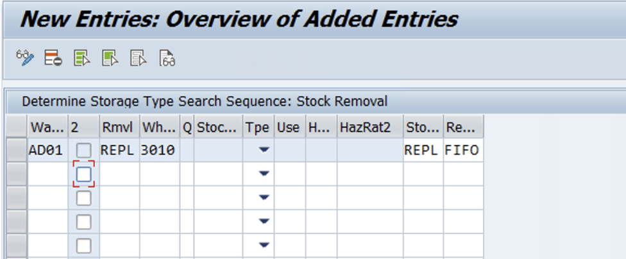
Determine Storage Type Search Sequence for Stock Removal
SPRO-IMG-SCM Extended Warehouse Management-Extended Warehouse Management-Goods Issue Process-Strategies- Determine Storage Type Search Sequence for Stock Removal
www.anubhavtrainings.com

Slide 16
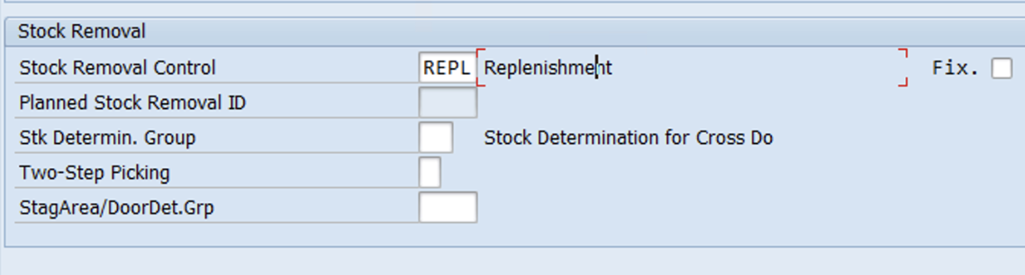
Maintain Stock removal indicator in Product master
www.anubhavtrainings.com

Slide 17
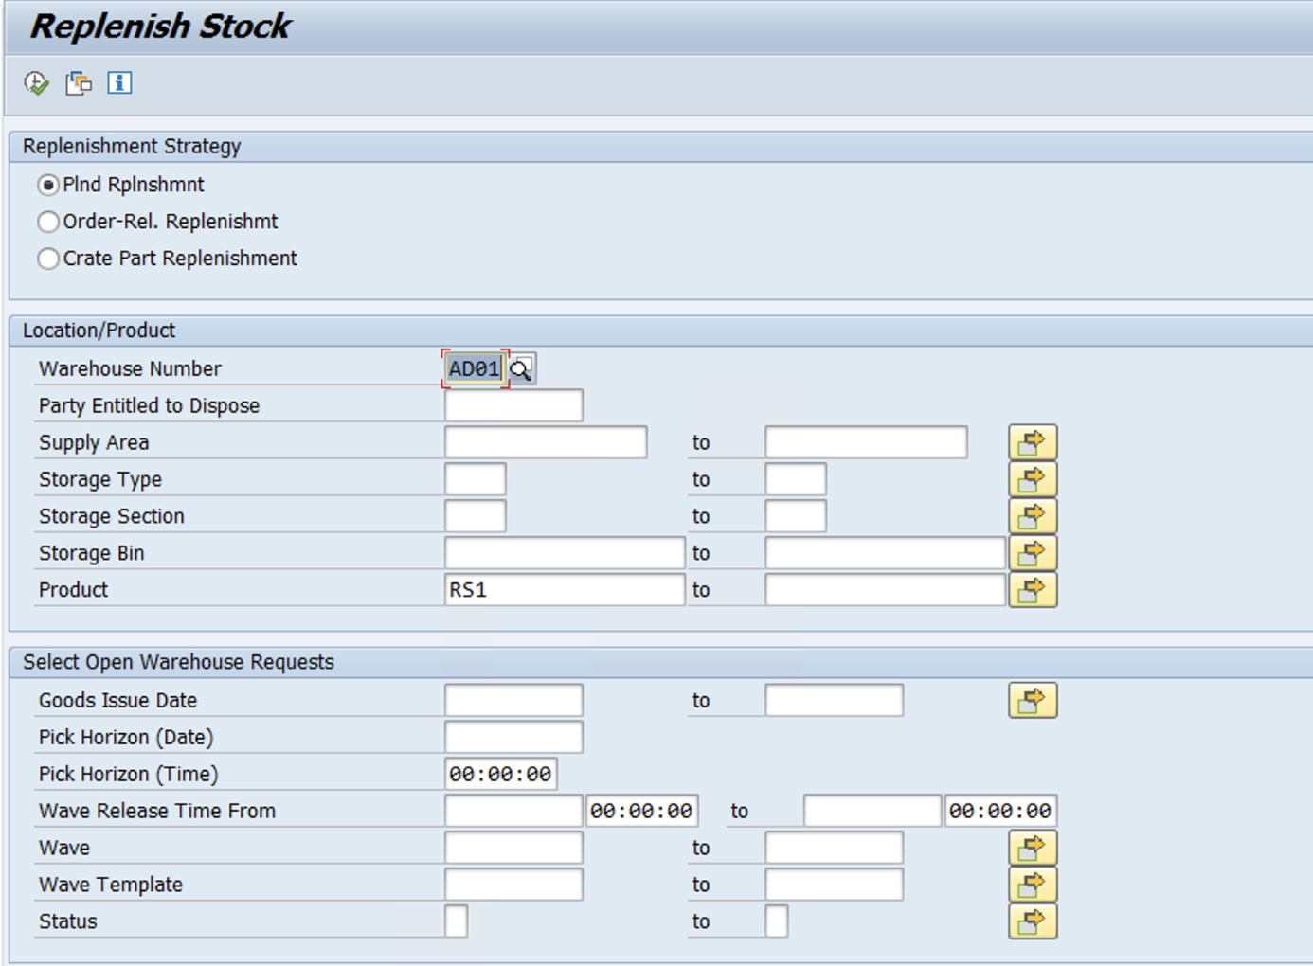
Test Case
Replenishment using tcode - /scwm/repl
www.anubhavtrainings.com

Slide 18
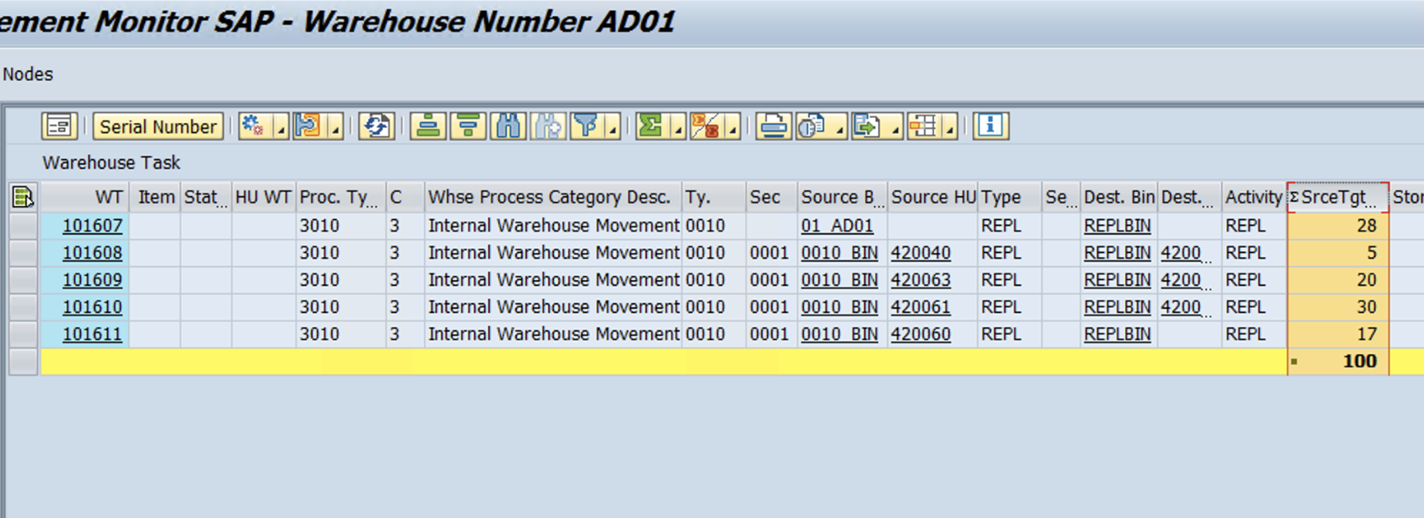
After executing this transaction, Line item with product/St type/ REPL St bin/Repl qty will be shown.
Select the line item and execute it. >> WTs will be created for replenishment activity.
www.anubhavtrainings.com

Slide 19
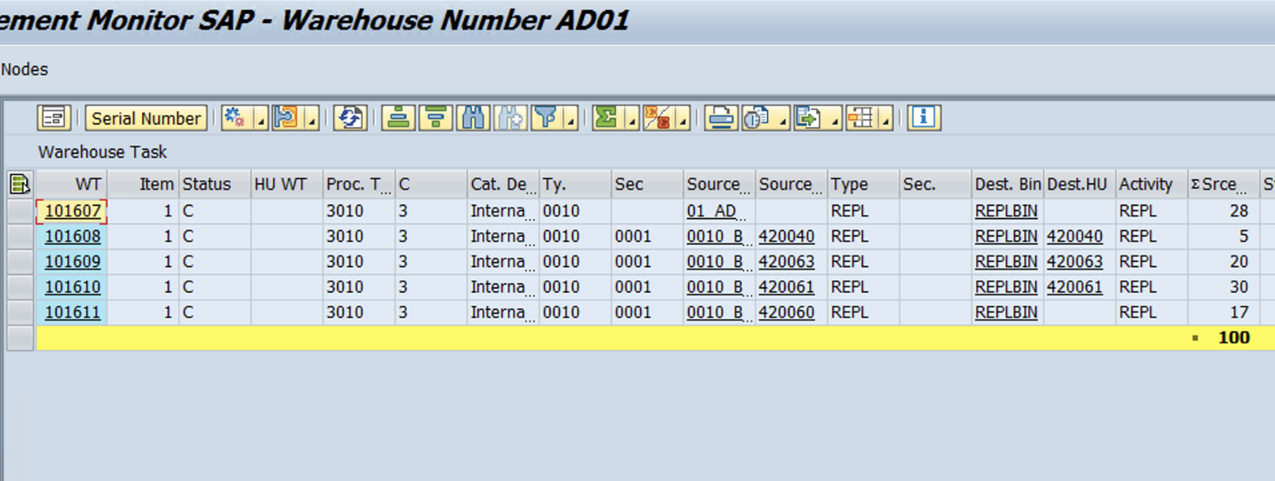
Here REPL qty was 100, System has created 5 WTs from to fulfill the stock.
Confirm all the WTs
www.anubhavtrainings.com

Slide 20


End of Session 15
www.anubhavtrainings.com

Slide 21

FEEL FREE TO ASK QUESTIONS

Slide 22

Feedback

Slide 23
THANK
YOU

Slide 24




More from AnubhavTrainings.com

Slide 25






We’re committed to empower you to be
#FutureReady
through powerful training solutions.
We build the workforce of the future.
250+
Corporate Clients
30,000+
Learners Trained
25000+
Learners Placed
FREE WEBINARS
Sign up for free webinars with industry experts every fortnight!
Enroll Now!

Slide 26
FREE WEBINARS
Sign up for free webinars with industry experts every fortnight!
Contact us today!
www.anubhavtrainings.com

